Slide 1


Bayesian Workflow
Andrew Johnson
Aalto University
Nordic Probabilistic AI School 2024

Slide 2
Outline
Bayesian Inference
MCMC Sampling
HMC/NUTS & Stan
Bayesian Workflow
Step-by-Step Workflow: Epilepsy RCT
Conclusions

Slide 3
Why Bayesian Inference?
We have knowledge and assumptions beyond just the current observations
We have some uncertainty in our predictions/beliefs

Slide 4
Bayesian Inference
Let’s make a bet on what a new friend does for a living
Meet Avery
Is Avery a:
Farmer
Librarian

Slide 5
Bayesian Inference
What observations and what assumptions do we have at this stage?
Observations:
None
Assumptions:
None
Prediction:
Avery is equally likely to be a farmer or a librarian, and we have no certainty in our prediction

Slide 6
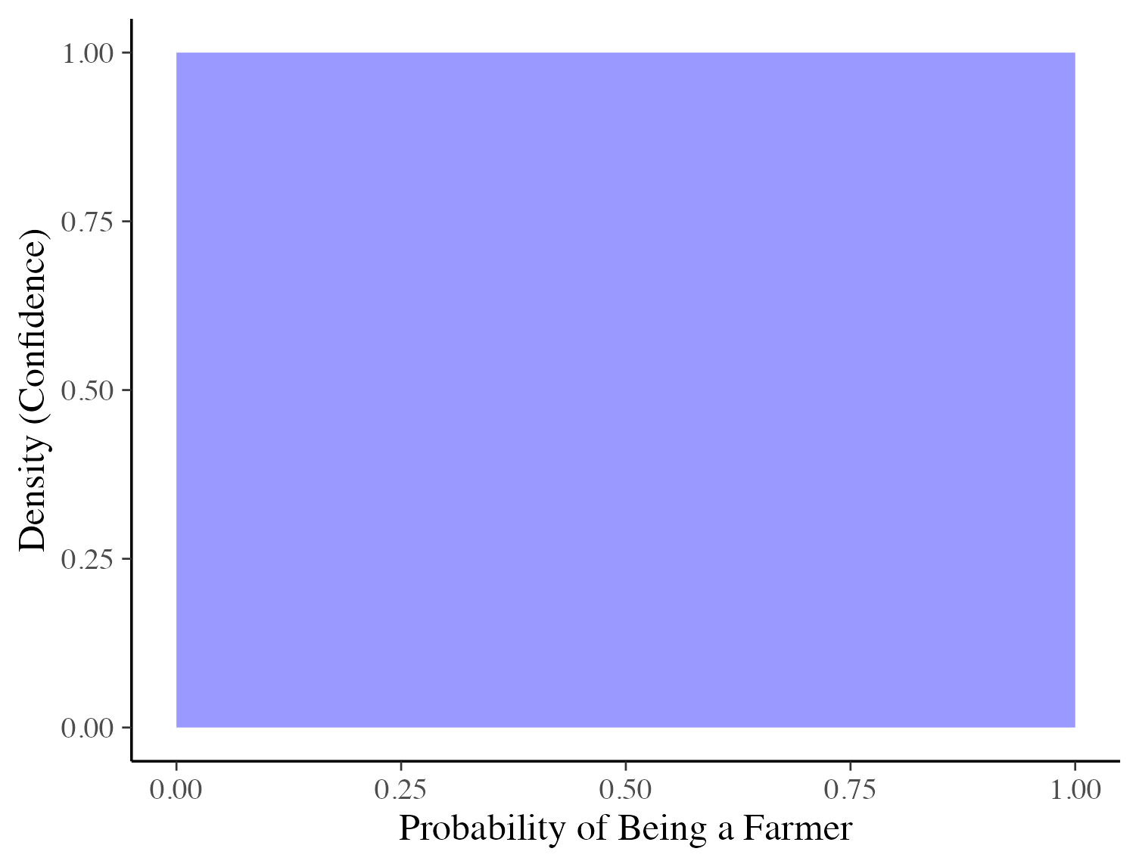
Bayesian Inference
Every probability of Avery being a farmer is possible
We consider every probability to be equally likely

Slide 7
Bayesian Inference
What if Avery told you a bit more about themselves?
Observations:
Avery prefers structure and organisation
They are generally described as ‘quiet’ and ‘introverted’
Assumptions:
None
Prediction:
We predict that Avery is more likely to be a librarian than a farmer
How confident should we be in this prediction? Why?

Slide 8
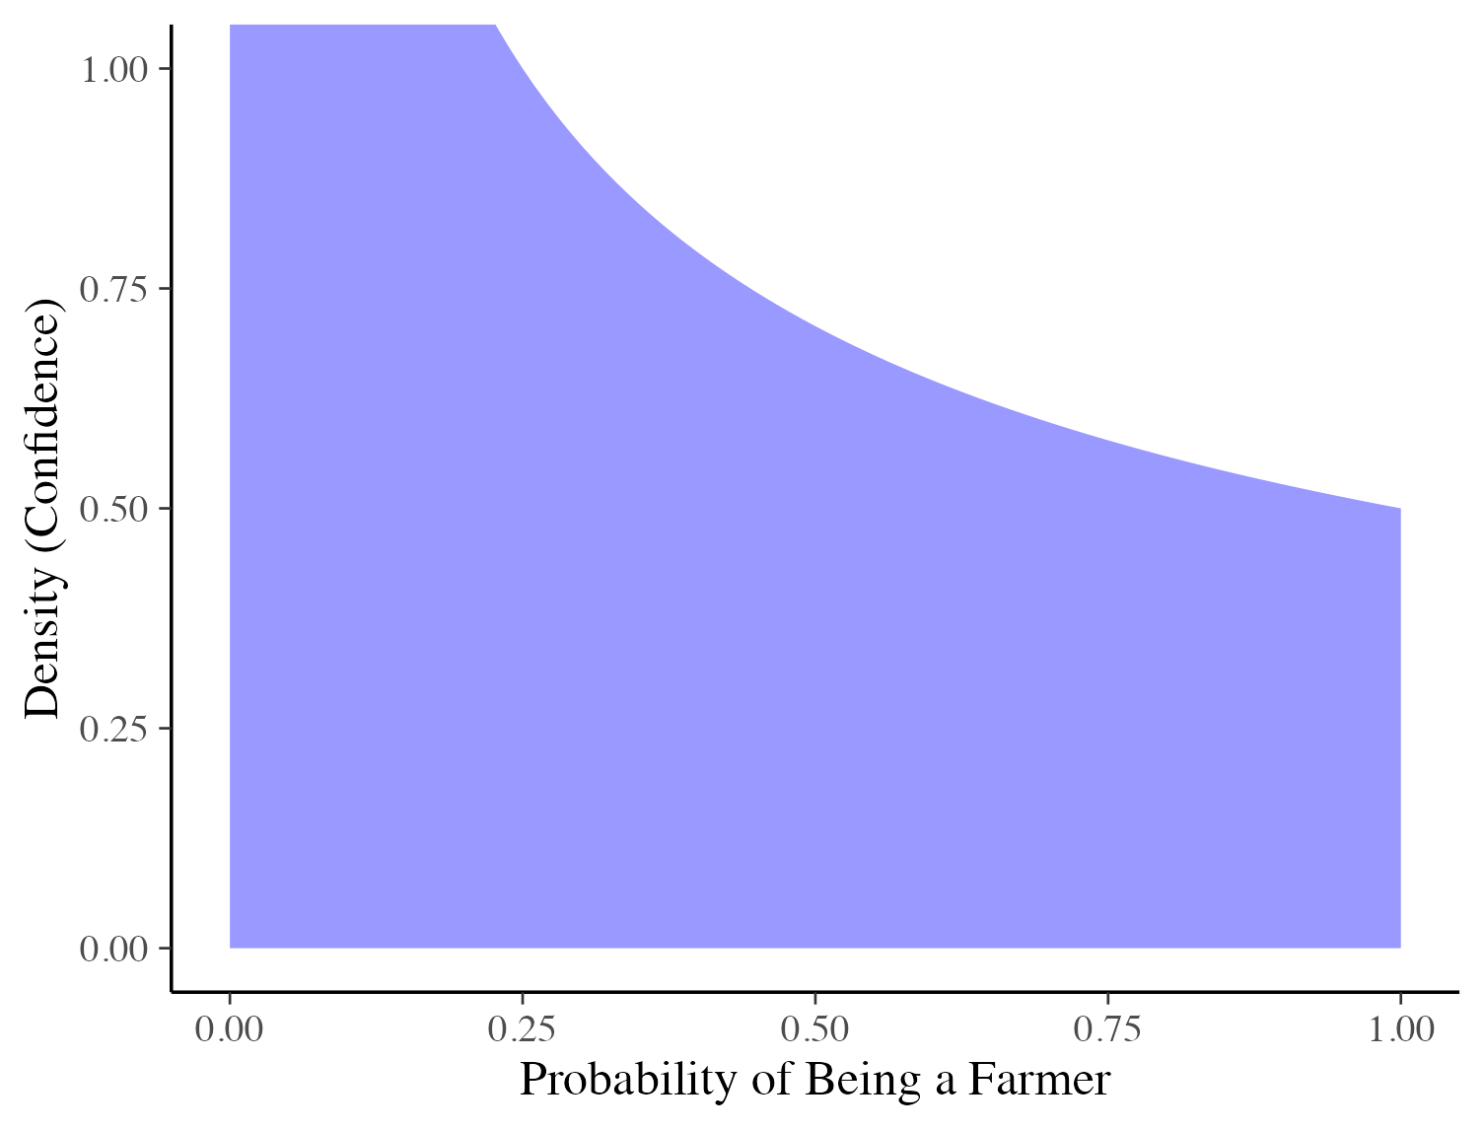
Bayesian Inference
We believe that the probability of being a farmer is small, but we might still be wrong
We have more confidence in lower probabilities than higher probabilities
What if we had some idea about the probability of any given person being a farmer?

Slide 9
Bayesian Inference
What if you knew some worldwide occupation statistics?
Observations:
Avery prefers structure and organisation
They are generally described as ‘quiet’ and ‘introverted’

Slide 10
Bayesian Inference
What if you knew some worldwide occupation statistics?
Observations:
Avery prefers structure and organisation
They are generally described as ‘quiet’ and ‘introverted’
Assumptions:
Farmer: 874 Million worldwide (2020)¹
Librarian 1.6 Million worldwide (2020)²
1. https://librarymap.ifla.org/map/Metric/Full-Time-Staff/LibraryType/National-Libraries,Academic-Libraries,Public-Libraries,Community-Libraries,School-Libraries,Other-Libraries/Weight/Totals-by-Country
2. https://reliefweb.int/report/world/fao-statistical-yearbook-2021-world-food-and-agriculture

Slide 11
Bayesian Inference
What if you knew some worldwide occupation statistics?
Observations:
Avery prefers structure and organisation
They are generally described as ‘quiet’ and ‘introverted’
Assumptions:
Farmer: 874 Million worldwide (2020)¹
Librarian 1.6 Million worldwide (2020)²
Prediction:
We predict that Avery is much more likely to be a farmer than a librarian
How much additional certainty/influence should worldwide statistics add?
1. https://librarymap.ifla.org/map/Metric/Full-Time-Staff/LibraryType/National-Libraries,Academic-Libraries,Public-Libraries,Community-Libraries,School-Libraries,Other-Libraries/Weight/Totals-by-Country
2. https://reliefweb.int/report/world/fao-statistical-yearbook-2021-world-food-and-agriculture

Slide 12
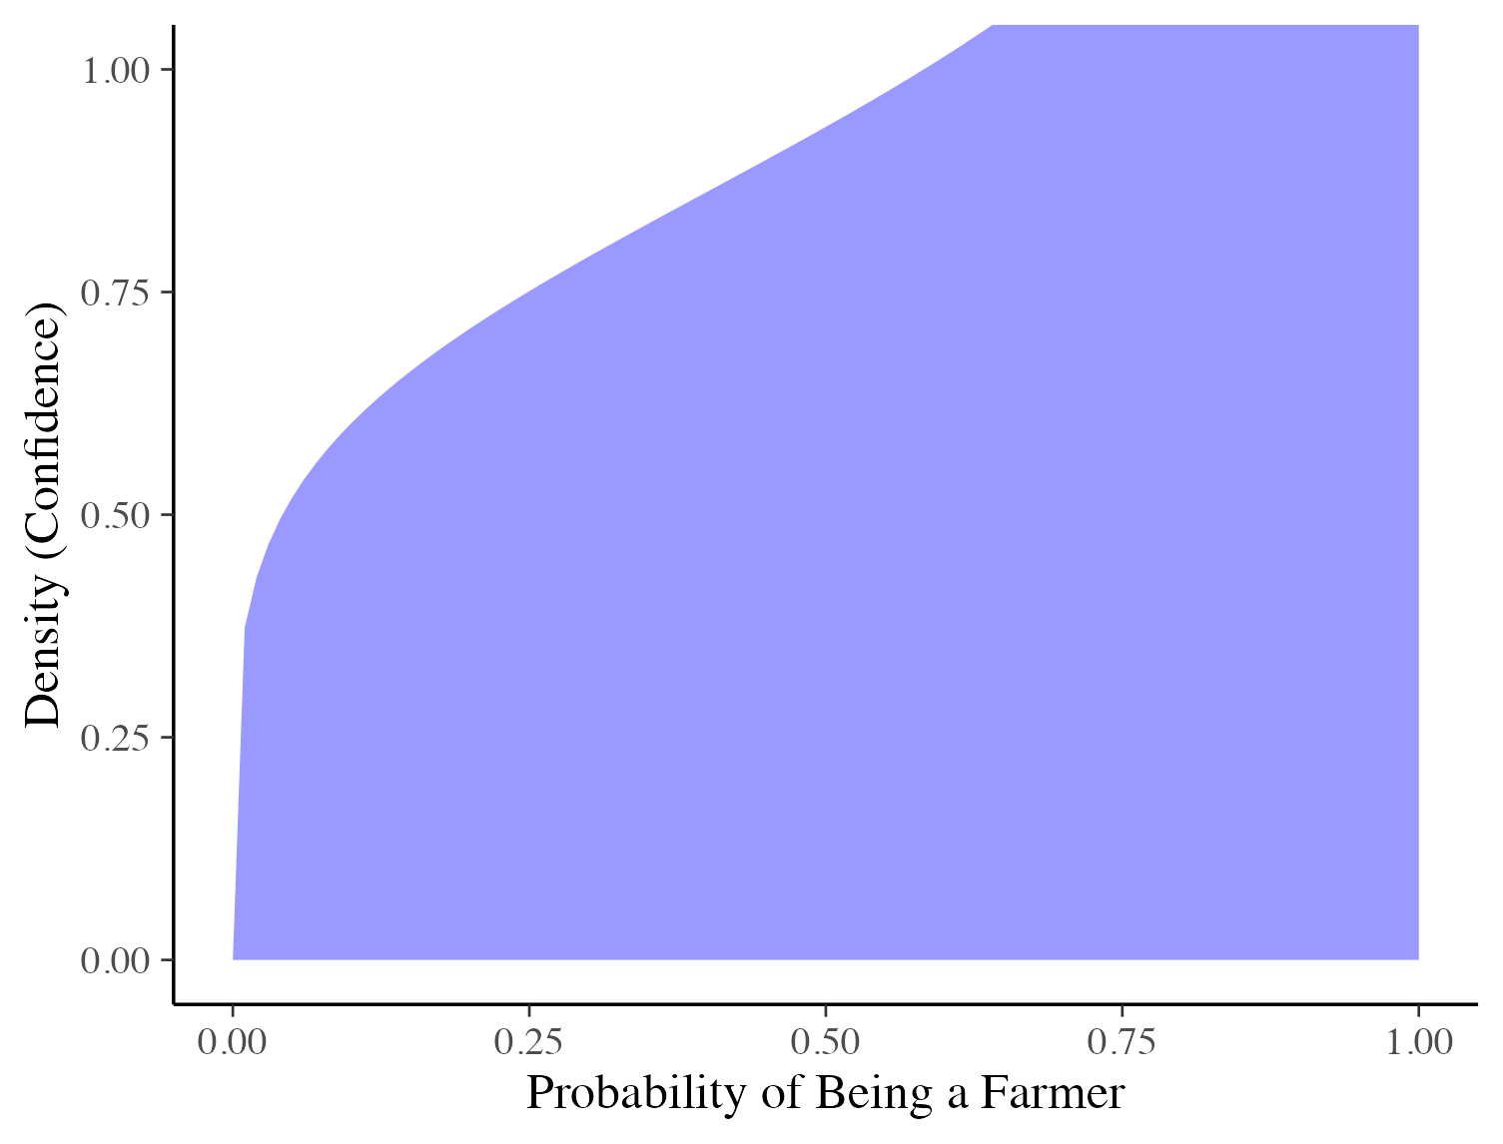
Bayesian Inference
Considering the global probability of being a farmer, we predict Avery more likely to be a farmer
Without knowing where Avery lives, we don’t have strong confidence in the information provided by the global probability
What if we knew more about Avery? How does our confidence in our prior change the influence of that information?

Slide 13
Bayesian Inference
Let’s learn some more about Avery:
Observations:
Avery prefers structure and organisation
They are generally described as ‘quiet’ and ‘introverted’
Avery loves books and spends most afternoons at the library
Assumptions:
Farmer: 874 Million worldwide (2020)¹
Librarian 1.6 Million worldwide (2020)²

Slide 14
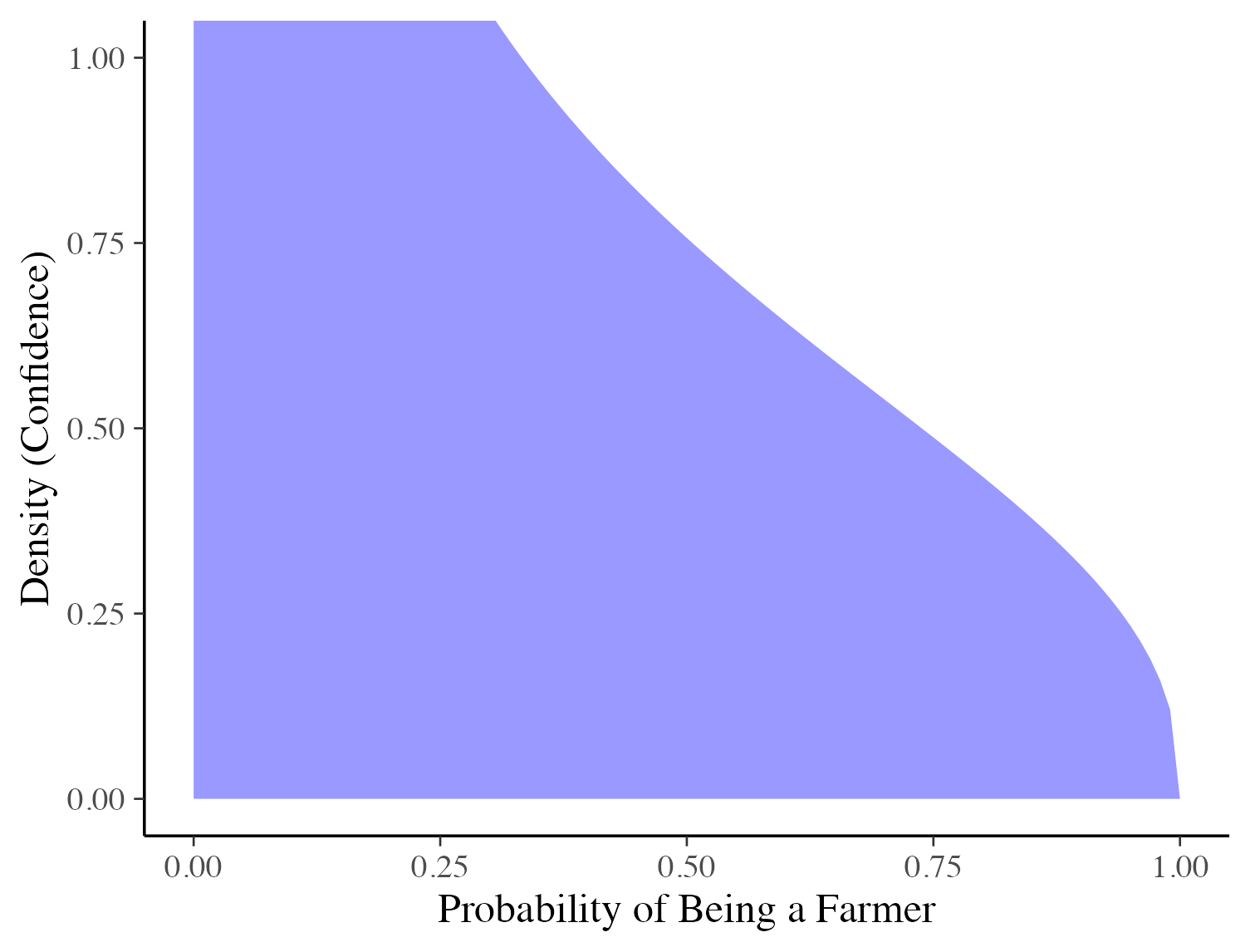
Bayesian Inference
Because we don’t have strong confidence in our prior, we give more weight to our observations
We predict that Avery is more likely to be a librarian, and we have a strong level of confidence in that prediction
But what would happen if we had very strong prior information?

Slide 15
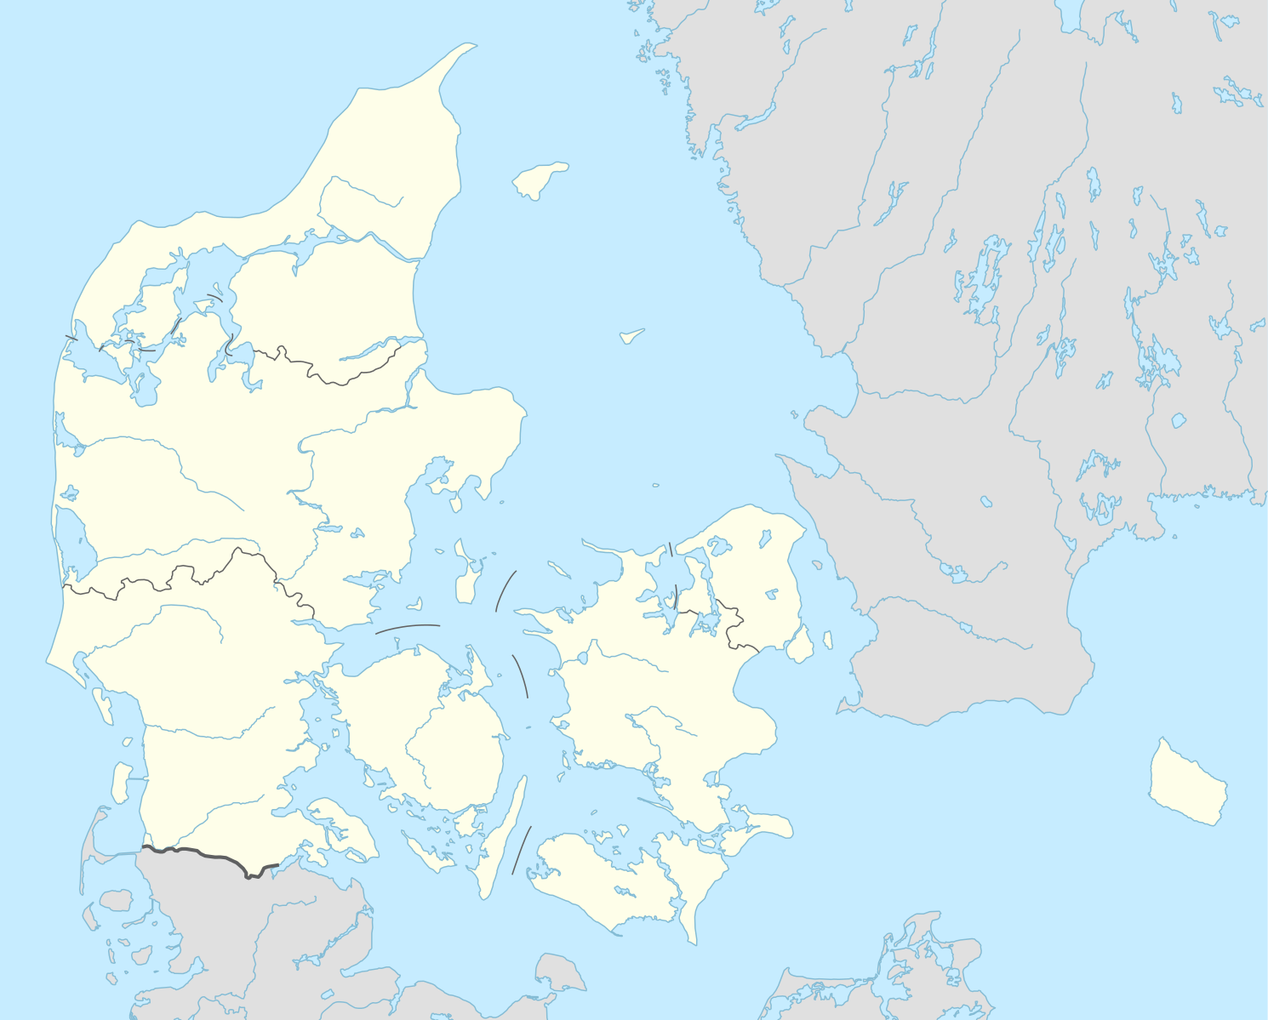
Bayesian Inference
What if you knew that Avery was from:
Denmark

Slide 16
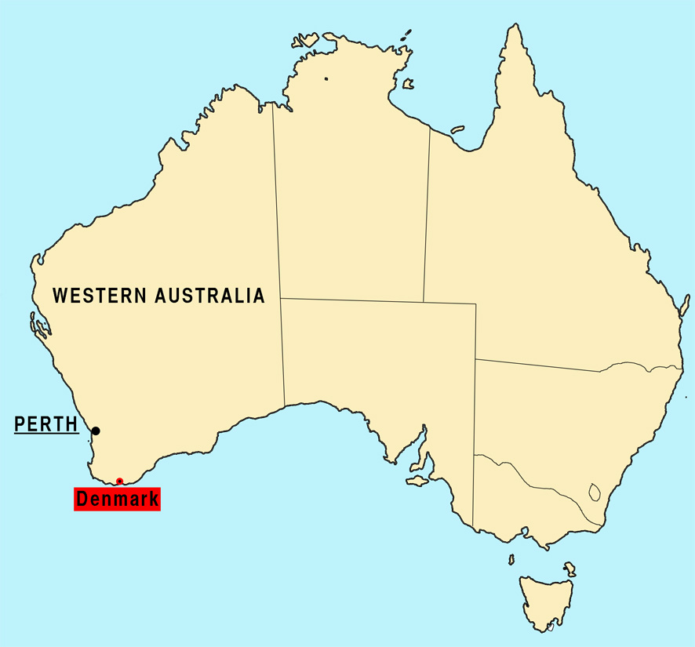
Bayesian Inference
What if you knew that Avery was from:
Denmark, Australia
Population 6,422
Primary industry is agriculture
Only 2 full-time librarians
What does this mean for our predictions about Avery?

Slide 17
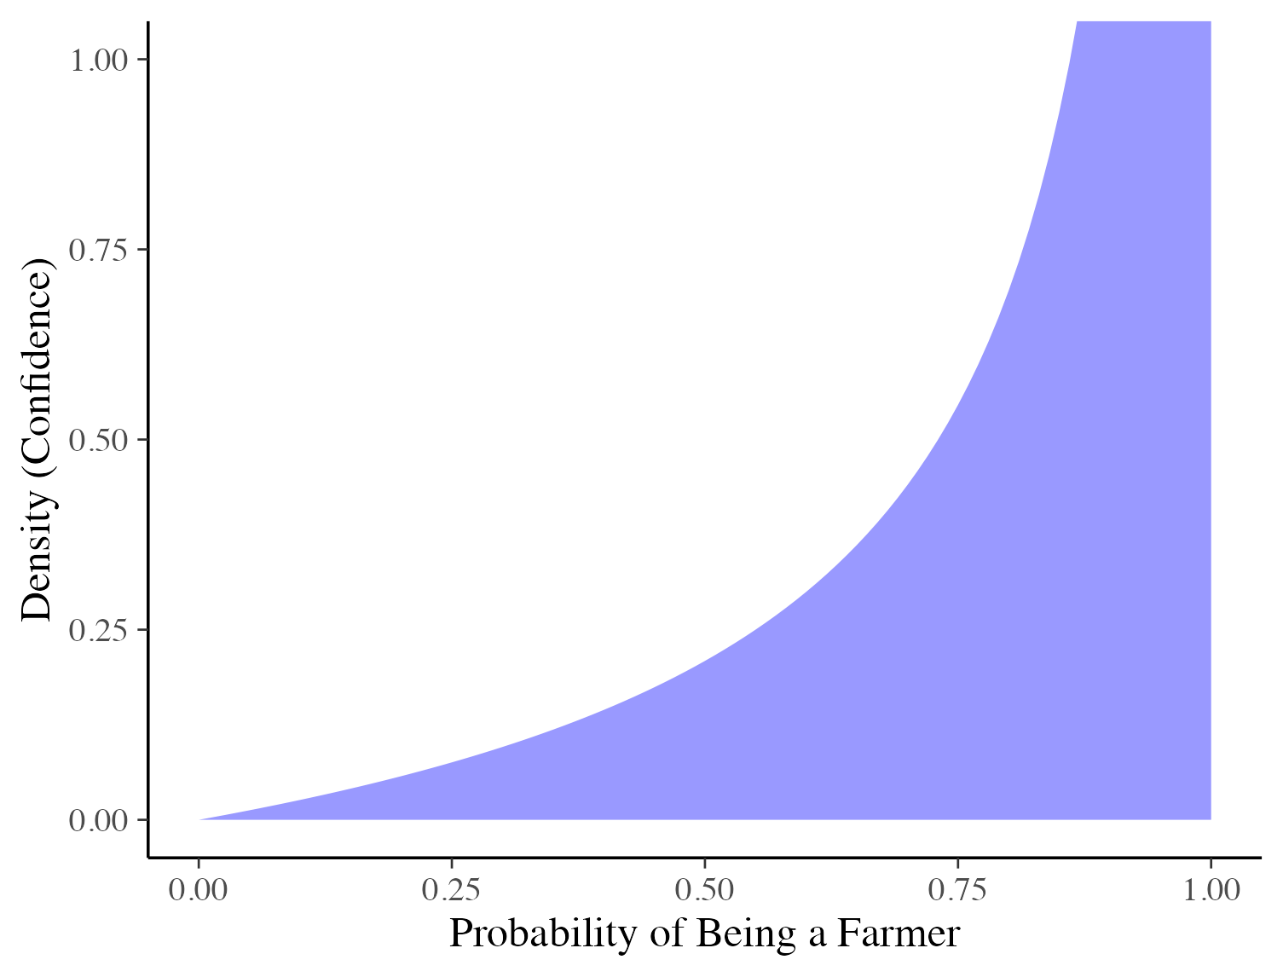
Bayesian Inference
Our prior information tells us that Avery is very highly likely to be a farmer, regardless of their personality
The strength of this prior information means that we need more and more observations about Avery before we would change our prediction

Slide 18

Bayesian Inference – Key Takeaways
We consider both our observations and external/prior information when making predictions
Our strength of confidence/certainty in these also influence our confidence/certainty in our predictions
If one of them is “weak” then the other will drive our predictions and certainty

Slide 19

Components of Bayesian Inference
$$p\left(θ | y\right)∝p\left(y | θ\right)p(θ)$$
$p(θ)$: Prior Knowledge
What is the probability of a person being a farmer?
$p\left(y | θ\right)$: Likelihood
How does Avery’s personality contribute to their probability of being a farmer?
$p\left(θ | y\right)$: Posterior
What is the probability of Avery being a farmer?

Slide 20

Computation in Bayesian Inference
We want to make inferences using our posterior distribution:
$$p\left(θ | y\right)∝p\left(y | θ\right)p(θ)$$
The posterior distribution is not able to be specified in closed-form for majority of models
We need a numerical approximation: Markov Chain Monte Carlo

Slide 21
MCMC Sampling
Markov Chain Monte Carlo is a powerful tool for numerically computing expectations over complex/difficult distributions
Key component is the Markov chain
Sequential set of samples from a given target distribution
Each sample informs where the next sample should be drawn from (Markov transition)
Given enough time (and sampling), these will quantify the target distribution
Markov Chain Monte Carlo estimate is then the average of the target function over these samples

Slide 22

MCMC Sampling
Given target distribution (posterior):
$$p\left(θ\right|y)$$

Slide 23

MCMC Sampling
Given target distribution (posterior):
$$p\left(θ\right|y)$$
We estimate a Markov Chain for $N$ iterations ($N$ sequential samples):
$$\left\{s_{1},…,s_{N}\right\}$$

Slide 24

MCMC Sampling
Given target distribution (posterior):
$$p\left(θ\right|y)$$
We estimate a Markov Chain for $N$ iterations ($N$ sequential samples):
$$\left\{s_{1},…,s_{N}\right\}$$
Apply our target function to the Markov Chain samples:
$${\hat{f}}_{N}=\frac{1}{N}\sum_{n=0}^{N}{f(s_{n})}$$

Slide 25

MCMC Sampling
Given target distribution (posterior):
$$p\left(θ\right|y)$$
We estimate a Markov Chain for $N$ iterations ($N$ sequential samples):
$$\left\{s_{1},…,s_{N}\right\}$$
Apply our target function to the Markov Chain samples:
$${\hat{f}}_{N}=\frac{1}{N}\sum_{n=0}^{N}{f(s_{n})}$$
This estimate converges to the true expectation:
$$\lim_{N→ ∞}{{\hat{f}}_{N}}= 𝔼_{p(θ|y)}\left[f\right]$$

Slide 26

MCMC Sampling
y
$$𝔼\left[f\right]− \hat{f}$$
Iteration
x

Slide 27
MCMC Sampling
Most bias present earliest
y
$$𝔼\left[f\right]− \hat{f}$$
Iteration
x

Slide 28
MCMC Sampling
Reduces once probability mass is found and initially explored
y
$$𝔼\left[f\right]− \hat{f}$$
Iteration
x

Slide 29
MCMC Sampling
Asymptotically tends to zero bias as exploration continues
y
$$𝔼\left[f\right]− \hat{f}$$
Iteration
x

Slide 30

MCMC Sampling
Asymptotically tends to zero bias as exploration continues
y
$$𝔼\left[f\right]− \hat{f}$$
Iteration
x
Note two sources of bias:
Finding probability mass
Fully exploring probability mass

Slide 31
HMC: Scaling Bayesian Inference
Traditional MCMC methods like MH & Gibbs (often, not always) struggle with increasing model complexity
Requires the specification of “tuning” parameters
Unique to the posterior at hand (in most cases)
A self-tuning version of HMC – the No U-Turn Sampler (NUTS) since been popularised by Stan
Hamiltonian Monte Carlo uses the gradient of the target probability density function to “guide” sampling
Parameter space to be explored becomes increasingly sparse as dimensionality increases

Slide 32
Stan
PPL providing estimation via:
MCMC Sampling
NUTS
HMC
Optimisation
Newton
BFGS
L-BFGS
Automatic Differentiation Variational Inference
Pathfinder Approximate Inference
Laplace Sampling

Slide 33
Stan-centricities
Strong static typing
Every variable must have a defined type that cannot change

Slide 34
Stan-centricities
Strong static typing
Every variable must have a defined type that cannot change
Easy Vectorisation
Functions & distributions take either/both scalars and containers
Allows for re-using expensive computation and efficient handling of large inputs

Slide 35
Stan-centricities
Strong static typing
Every variable must have a defined type that cannot change
Easy Vectorisation
Functions & distributions take either/both scalars and containers
Allows for re-using expensive computation and efficient handling of large inputs
Compiled vs. Interpreted Language
PPL’s like Pyro or JAGS/BUGS directly execute (“interpret”) the commands given
Stan models are translated to C++ and compiled to machine code for execution

Slide 36
Stan-centricities
Compiled Language Benefits
Reduces overhead – only the code needed for the model is executed
Compilers are *very* good at optimising code for efficient execution
Machine-specific optimisations (e.g., SIMD)
Compiled Language Limitations
Additional time & resource usage for compilation
Requires working C++ toolchain for compilation
Reduces accessibility for new users

Slide 37
How do we take some observations and prior information and turn it into a model?
How can we be confident we’ve made good modelling choices?
Bayesian Workflow, of course

Slide 38
Bayesian Workflow
What is it and why would I need it?
Bayesian inference is powerful, but model development can be a complex process
Multiple options for prior & likelihood choice
Multiple ways to specify the same prior & likelihood
Can lead to series of ad-hoc decisions and discarded models
We need a systematic, but flexible, process to follow

Slide 39
Bayesian Workflow
Three broad stages of Bayesian modelling:
Model Building
Inference
Model Checking/Improvement
Each stage naturally covers multiple issues/tasks
The results from one stage can require returning to earlier stages to make changes
Iterative process

Slide 40
Principles of Bayesian Workflow
Systematic
Replace ad-hoc decision-making with recommended, evidence-based, guidance
Flexible
Every analysis is different
Rigid set of steps to follow will result in poorer results for some
Practical
Time and resources are not infinite
Want a robust process while reducing unnecessary effort and time
Fail early, fail fast

Slide 41
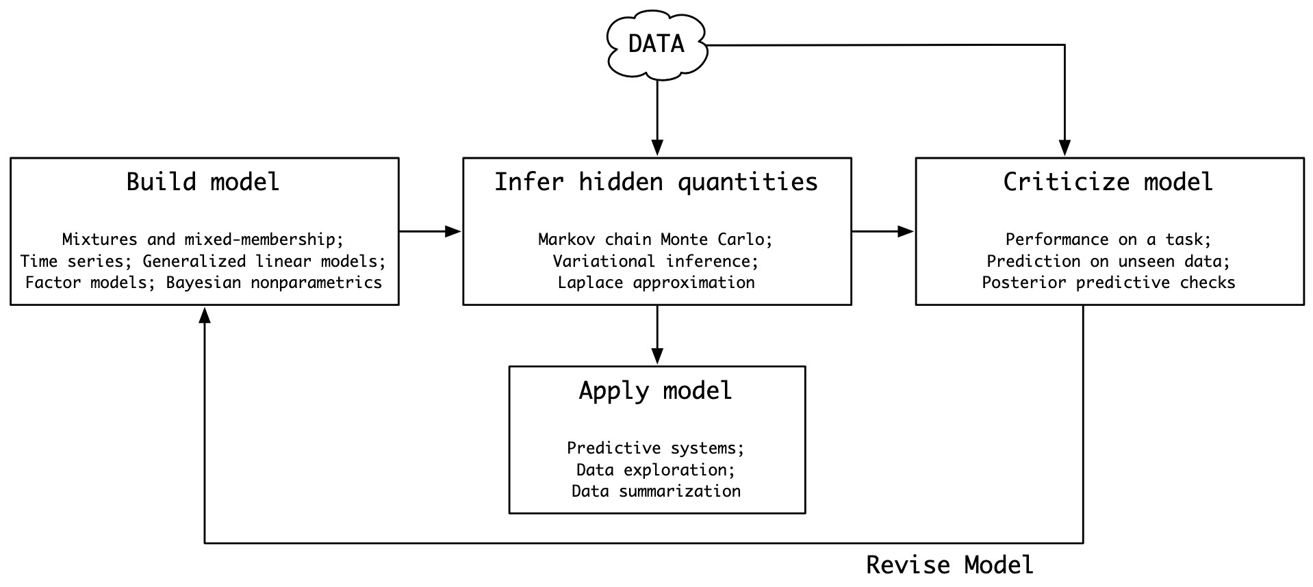
Early Workflow
Early modelling workflow proposed by Box, popularised by David Blei (2014) is Box’s Loop:

Slide 42
Gelman et al. (2020)
Proposed series of steps to follow
Application & interpretation of diagnostics
Early identification of model-misspecification
Assessing computational & model trustworthiness before inference

Slide 43
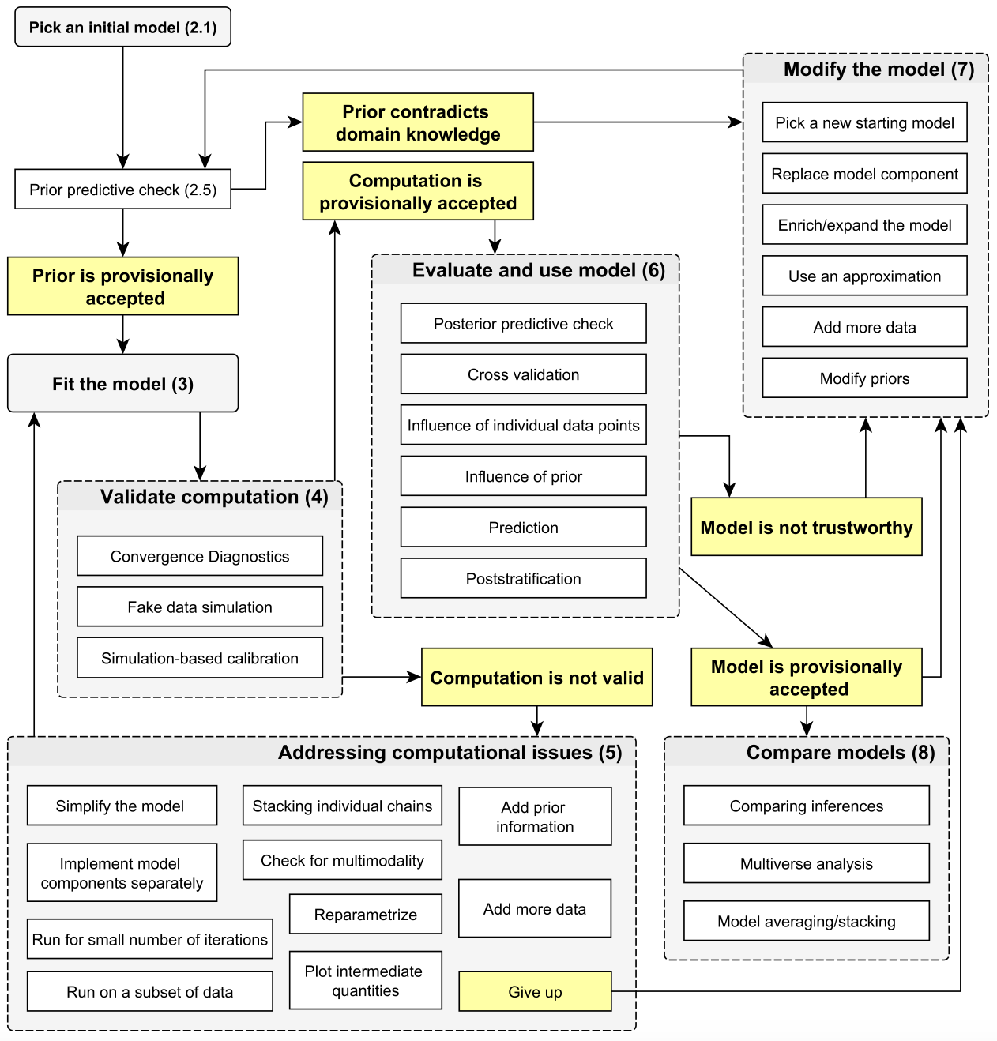
Gelman et al. (2020)
Proposed series of steps to follow
Application & interpretation of diagnostics
Early identification of model-misspecification
Assessing computational & model trustworthiness before inference

Slide 44
What have we done so far?
Established why we might want to apply a Bayesian model
Introduced the statistical/computational methods we will need for estimating a Bayesian model
Introduced the PPL we will use for specifying a Bayesian model
Introduced the concept of a Bayesian Workflow
How do we put this into
practice?

Slide 45
The Problem
Randomised-controlled trial for a new epilepsy drug:
59 participants
Control: 28
Treatment: 31
4 assessments (plus baseline)
Predictors:
Age of participant
Baseline number of seizures
Outcome: number of seizures since last visit

Slide 46
The Workflow

Slide 47
Initial Model - Hypothesis
What do we hypothesise are the relationships between our predictors and our outcome?

Slide 48
Initial Model - Hypothesis
What do we hypothesise are the relationships between our predictors and our outcome?
Age:
We expect age to affect the efficacy of the drug
Baseline Seizures:
We expect participants with more baseline seizures will show a greater response
Time:
We expect the number of seizures to change throughout the trial
Time x Treatment
We expect this change over time to be different between the treatment & control

Slide 49
Initial Model - Likelihood
Let’s start with a simple linear regression
Outcome:
Number of seizures
Predictors:
Treatment
Age
Baseline seizures
Time
Time * Treatment

Slide 50

Initial Model - Stan
How do we turn this into a Stan model?
First, let’s write our current joint (log-)likelihood:
$$\sum_{i=1}^{N∗T}{\ln{N\left(y_{i}|α+x_{i}^{T}β, σ^{2}\right)}}$$
Remembering that:
$$x_{i}^{T}β=\sum_{k=1}^{K}{x_{ik}β_{k}}$$

Slide 51
Initial Model - Stan
functions {}
data {}
parameters {}
transformed parameters {}
model {}
generated quantities {}
Stan models are specified in “blocks”
For now, we only need to consider a subset of these

Slide 52
Initial Model - Stan
data {}
parameters {}
model {}

Slide 53

Initial Model - Stan
data {}
parameters {}
model {}
Given our joint (log-)likelihood function:
$$\sum_{i=1}^{N∗T}{\ln{N\left(y_{i} | α+\sum_{k=1}^{K}{x_{ik}β_{k}}, σ^{2}\right)}}$$

Slide 54

Initial Model - Stan
data {}
parameters {}
model {}
Given our joint (log-)likelihood function:
$$\sum_{i=1}^{N∗T}{\ln{N\left(y_{i} | α+\sum_{k=1}^{K}{x_{ik}β_{k}}, σ^{2}\right)}}$$
What elements are data?
Fixed values
Known in advance

Slide 55
Initial Model - Stan
data {
int N;
int T;
int K;
matrix[N*T, K] x;
vector[N*T] y;
}
parameters {}
model {}
Given our joint (log-)likelihood function:
$$\sum_{i=1}^{N∗T}{\ln{N\left(y_{i} | α+\sum_{k=1}^{K}{x_{ik}β_{k}}, σ^{2}\right)}}$$
What elements are data?
Fixed values
Known in advance

Slide 56

Initial Model - Stan
data {
int N;
int T;
int K;
matrix[N*T, K] x;
vector[N*T] y;
}
parameters {}
model {}
Given our joint (log-)likelihood function:
$$\sum_{i=1}^{N∗T}{\ln{N\left(y_{i} | α+\sum_{k=1}^{K}{x_{ik}β_{k}}, σ^{2}\right)}}$$
What elements are parameters?
Random variables
To be estimated

Slide 57
Initial Model - Stan
data {
int N;
int T;
int K;
matrix[N*T, K] x;
vector[N*T] y;
}
parameters {
real alpha;
vector[K] beta;
real<lower=0> sigma;
}
model {}
Given our joint (log-)likelihood function:
$$\sum_{i=1}^{N∗T}{\ln{N\left(y_{i} | α+\sum_{k=1}^{K}{x_{ik}β_{k}}, σ^{2}\right)}}$$
What elements are parameters?
Random variables
To be estimated

Slide 58

Initial Model - Stan
data {
int N;
int T;
int K;
matrix[N*T, K] x;
vector[N*T] y;
}
parameters {
real alpha;
vector[K] beta;
real<lower=0> sigma;
}
model {}
Given our joint (log-)likelihood function:
$$\sum_{i=1}^{N∗T}{\ln{N\left(y_{i} | α+\sum_{k=1}^{K}{x_{ik}β_{k}}, σ^{2}\right)}}$$
What likelihood are we using for our data and parameters?

Slide 59
Initial Model - Stan
data {
int N;
int T;
int K;
matrix[N*T, K] x;
vector[N*T] y;
}
parameters {
real alpha;
vector[K] beta;
real<lower=0> sigma;
}
model {
y ~ normal(alpha + x * beta, sigma);
}
Given our joint (log-)likelihood function:
$$\sum_{i=1}^{N∗T}{\ln{N\left(y_{i} | α+\sum_{k=1}^{K}{x_{ik}β_{k}}, σ^{2}\right)}}$$
What likelihood are we using for our data and parameters?

Slide 60
Initial Model - Stan
data {
int N;
int T;
int K;
matrix[N*T, K] x;
vector[N*T] y;
}
parameters {
real alpha;
vector[K] beta;
real<lower=0> sigma;
}
model {
y ~ normal_id_glm(x, alpha, beta,
sigma);
}
Given our joint (log-)likelihood function:
$$\sum_{i=1}^{N∗T}{\ln{N\left(y_{i} | α+\sum_{k=1}^{K}{x_{ik}β_{k}}, σ^{2}\right)}}$$
What likelihood are we using for our data and parameters?

Slide 61

Initial Model - Priors
Previous literature and pilot studies are not available to help with specifying informative priors
We’ll instead use weakly-informative priors
Regularise our estimates to feasible/possible values
We’ll use $N(0,5)$ priors for our coefficients and a half-normal $N^{+}\left(0,10\right)$ for our residual variance

Slide 62

Initial Model - Priors
Previous literature and pilot studies are not available to help with specifying informative priors
We’ll instead use weakly-informative priors
Regularise our estimates to feasible/possible values:
$$α\sim N\left(0,10\right)$$
$$β\sim N(0,5)$$
$$σ\sim N^{+}(0,5)$$

Slide 63

Initial Model - Priors
Previous literature and pilot studies are not available to help with specifying informative priors
We’ll instead use weakly-informative priors
Regularise our estimates to feasible/possible values:
$$α\sim N\left(0,10\right)$$
$$β\sim N(0,5)$$
$$σ\sim N^{+}(0,5)$$
Would it be a problem to specify the same prior for all covariates?

Slide 64

Initial Model - Priors
Let’s update our joint log-likelihood function with our priors:
$$\sum_{i=1}^{N∗T}{\ln{N\left(y_{i} | α+\sum_{k=1}^{K}{x_{ik}β_{k}}, σ^{2}\right)}}$$
$$+ \ln{N\left(α | 0, {10}^{2}\right)}$$
$$+ \ln{N\left(β | 0, 5^{2}\right)}$$
$$+ \ln{N\left(σ | 0, 5^{2}\right)}$$

Slide 65

Initial Model - Priors
Let’s update our joint log-likelihood function with our priors:
$$\sum_{i=1}^{N∗T}{\ln{N\left(y_{i} | α+\sum_{k=1}^{K}{x_{ik}β_{k}}, σ^{2}\right)}}$$
$$+ \ln{N\left(α | 0, {10}^{2}\right)}$$
$$+ \ln{N\left(β | 0, 5^{2}\right)}$$
$$+ \ln{N\left(σ | 0, 5^{2}\right)}$$
What part of our Stan model would we change?

Slide 66

Initial Model - Stan
data {...}
parameters {...}
model {
alpha ~ normal(0, 10);
beta ~ normal(0, 5);
sigma ~ normal(0, 5);
y ~ normal_id_glm(x, alpha, beta,
sigma);
}
Let’s update our joint log-likelihood function with our priors:
$$\sum_{i=1}^{N∗T}{\ln{N\left(y_{i} | α+\sum_{k=1}^{K}{x_{ik}β_{k}}, σ^{2}\right)}}$$
$$+ \ln{N\left(α | 0, {10}^{2}\right)}$$
$$+ \ln{N\left(β | 0, 5^{2}\right)}$$
$$+ \ln{N\left(σ | 0, 5^{2}\right)}$$
What part of our Stan model would we change?

Slide 67
Now we can fit our model!
…But should we?

Slide 68
Prior Predictive Check
What kind of observed data does this prior imply?
Process:
Simulate data from our prior
Compare to our observations
Allows us to identify whether model-misspecification is likely, before fitting the final model
Fail early!

Slide 69
Prior Predictive Check - Stan
model {
alpha ~ normal(0, 10);
beta ~ normal(0, 5);
sigma ~ normal(0, 5);
// Don’t model observed outcomes
// until we’re ready
if (sample_prior == 0) {
y ~ normal_id_glm(x, alpha, beta,
sigma);
}
}
generated quantities {
array[N*T] real ypred;
ypred = normal_rng(alpha + x * beta,
sigma);
}
We’ll use Stan to simulate the outcomes implied by our model’s priors

Slide 70
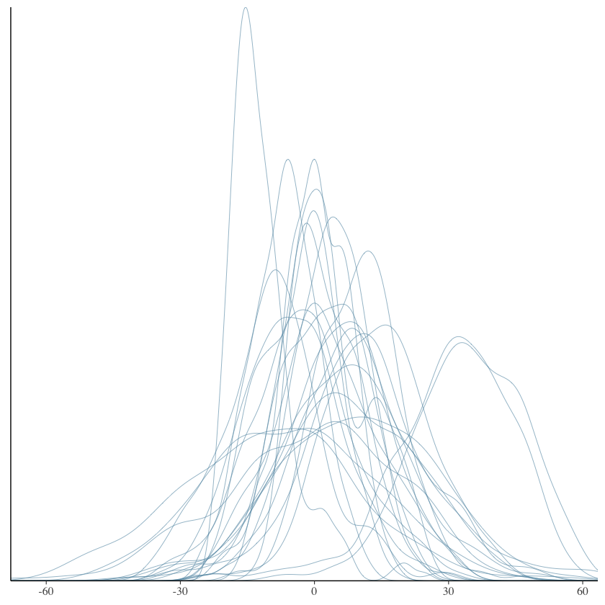
Prior Predictive Check
Why would we reject our model here?

Slide 71
Prior Predictive Check
Why would we reject our model here?
Model implies impossible values
Negative seizures

Slide 72
Prior Predictive Check - Failed
If the model or priors do not appear appropriate, what should you do?
Re-consider the data-generating process (likelihood) you’ve chosen – what does it imply for the actual phenomenon?
E.g., negative seizure counts?
Check your prior choices
Do they imply impossible values?

Slide 73

Modify the Model - Likelihood
Outcome is a count, so Poisson is a good start:
$$y_{i}∼\text{Poisson}(λ_{i})$$
For a Poisson Generalised Linear Model (GLM) we commonly use a log link:
$$λ_{i}=exp⁡(α+x_{i}^{T}β)$$

Slide 74
Modify the Model - Priors
Why is it essential to reconsider our priors here?

Slide 75

Modify the Model - Priors
Why is it essential to reconsider our priors here?
Coefficients are on the log-scale, so are multiplicative effects
$β=0.1; \exp\left(0.1\right)=1.105$
Implies a 10.5% increase
We’ll use $\text{Normal}(0,1)$ priors now

Slide 76
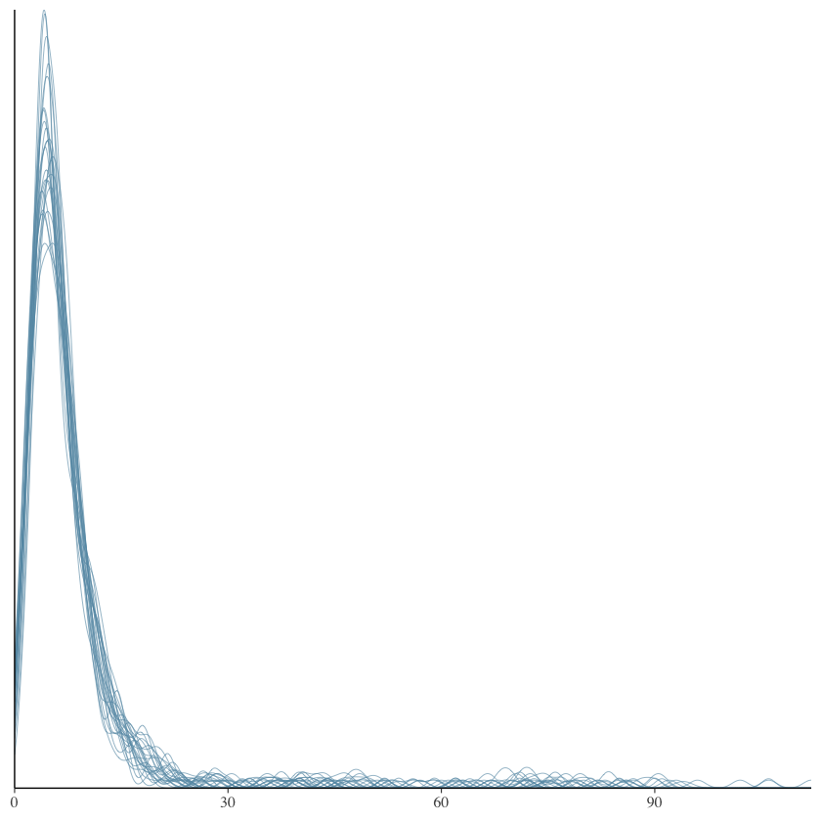
Prior Predictive Check
Much better!

Slide 77

Fit the Model & Validate
Once we’ve run the model, how do we know we can trust the results?
Recall the sources of bias from MCMC
Finding the probability mass
Fully exploring the probability mass
Convergence diagnostics
Traceplots and $\hat{R}$-statistic
Effective Sample Size

Slide 78
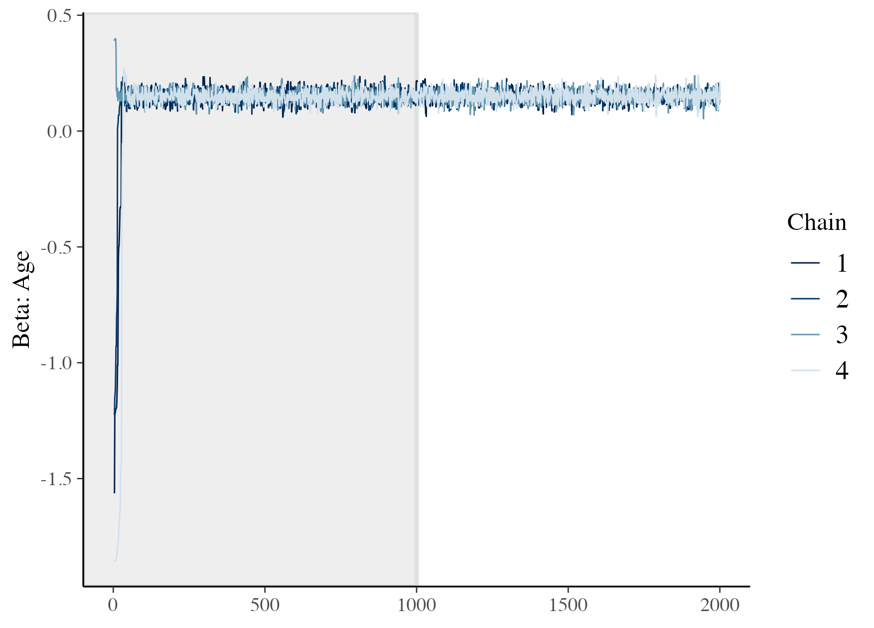
Traceplots
Graphically show the progression of chains during sampling
We want to see that all chains have found the same range of values
Also want to see that the full range of values has been sampled
Notice the strange points as the start?
Finding the probability mass
Discarded as “warm-up”

Slide 79
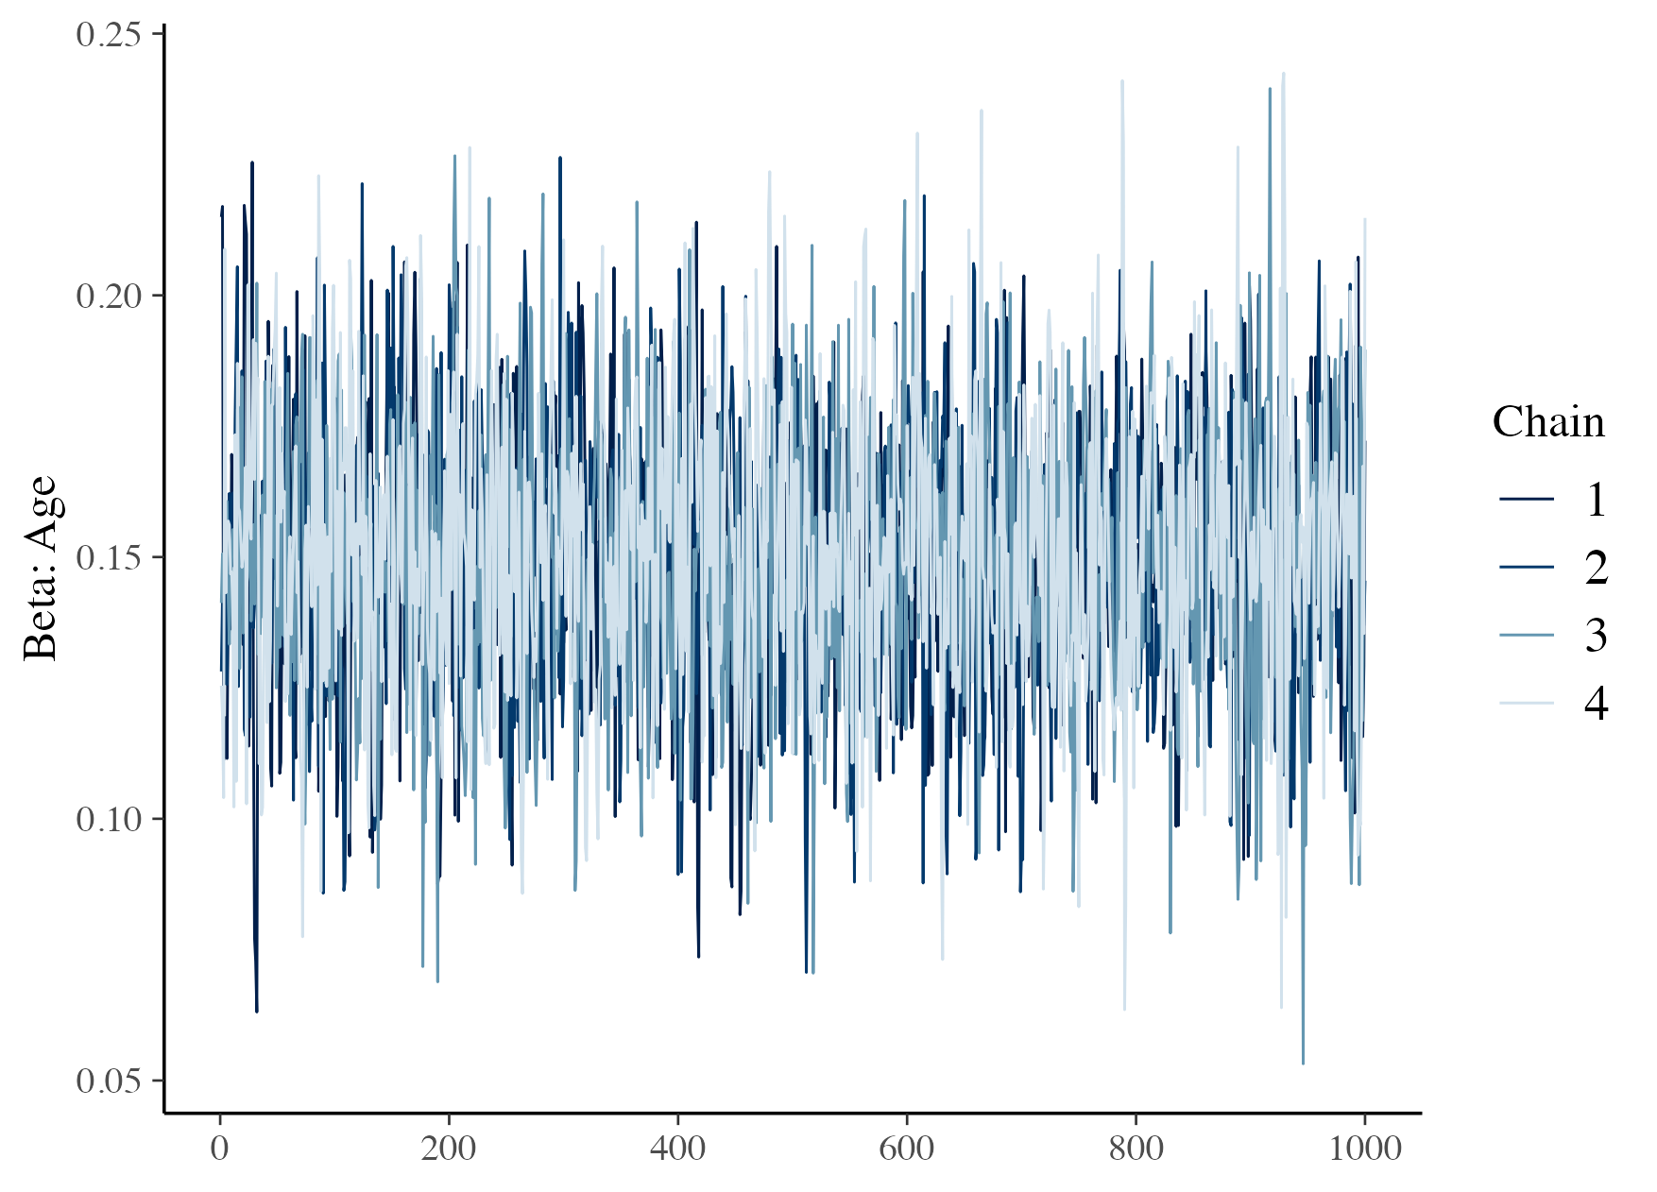

Traceplots
Convergence
If all chains have found the same range of values, and have explored them fully
An indication that the probability mass has been fully sampled
Start the chains from the diverse values to make sure
Supplement graphical inspection with $\hat{R}$-statistic:
Summarises variance within and between chains
We want values near 1

Slide 80
Effective Sample Size
MCMC estimator assumes independent samples
The greater the dependence, the greater the uncertainty in our estimates
Effective Sample Size (ESS) estimates the number of independent samples needed for the same uncertainty as our estimates
We inspect in two forms:
Bulk ESS: ESS in the ‘body’ of our posterior
Tail ESS: ESS in the tails

Slide 81
Evaluate Model
Once satisfied that there are no computational issues, we can assess whether the model is appropriate for our data
Good first step is Posterior-Predictive Checking
Simulate data from the posterior and assess difference from our observations

Slide 82
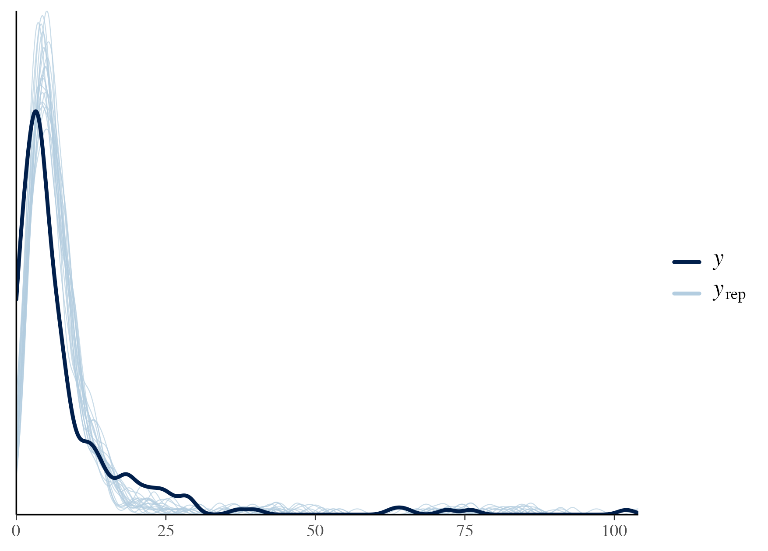
Posterior Predictive Check
Simulate data from the posterior and assess difference from our observations
Model appears to predict more smaller values than we have observed
How could we improve this?

Slide 83
Reject Model
What other model could we apply here?
Consider the assumptions made by our model

Slide 84

Reject Model
What other model could we apply here?
Consider the assumptions made by our model
Poisson assumes equal mean and variance
Let’s add some flexibility by including a random effect
Allows for greater variance than mean
New additions:
$$u_{i}∼Gamma\left(φ,φ\right)$$
$$φ∼Cauchy^{+}(0, 5)$$

Slide 85
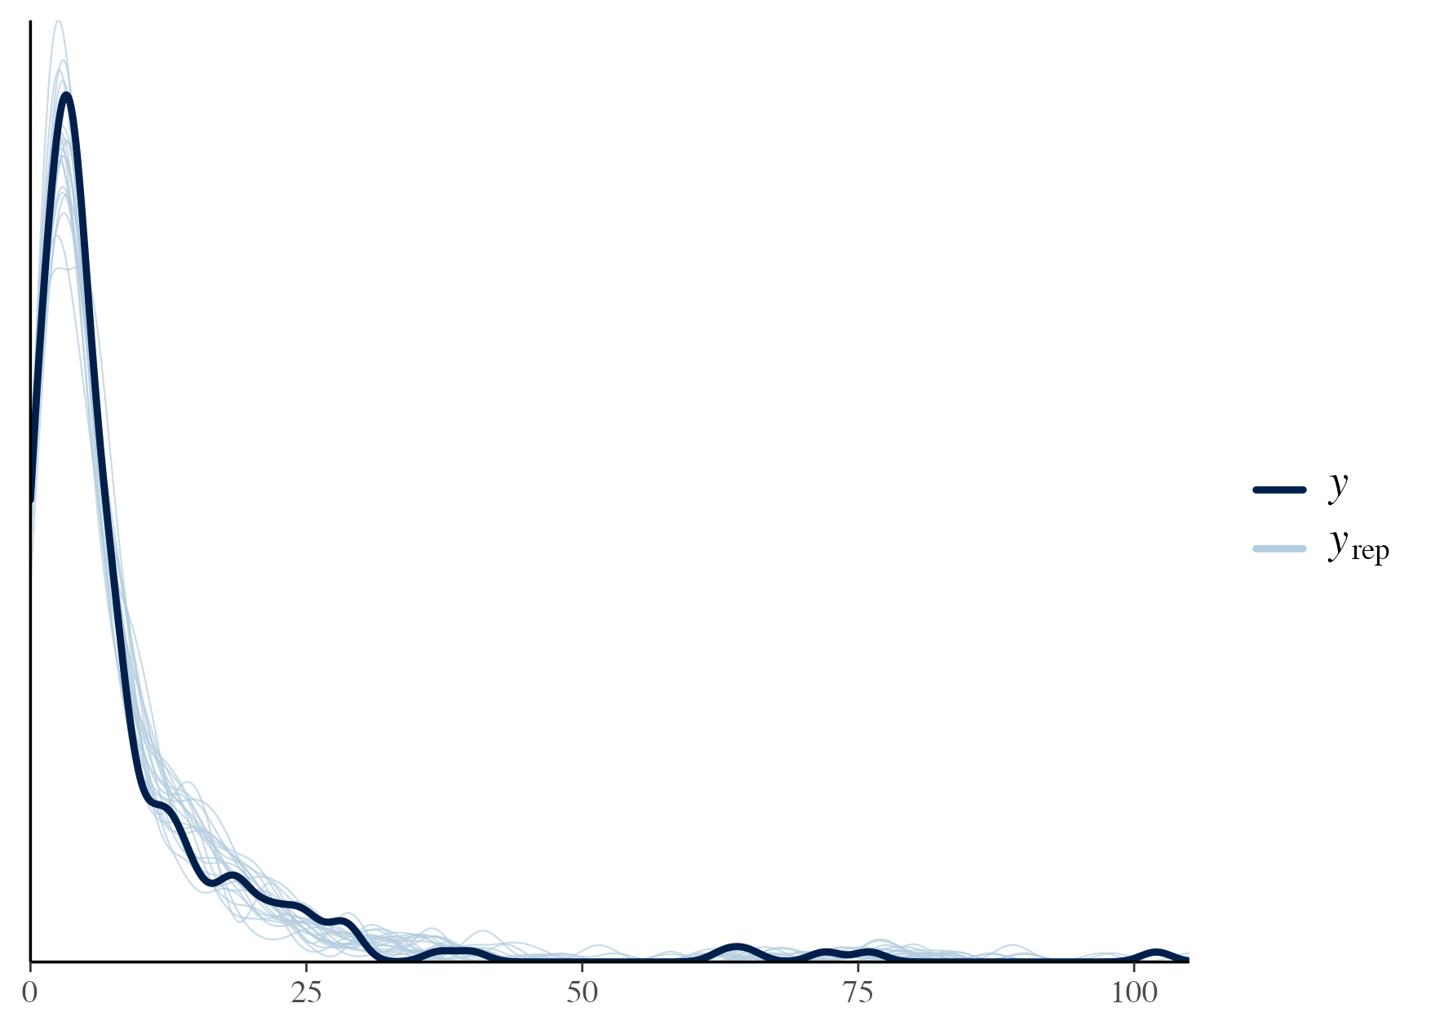
New Model
The posterior-predictive checks show much better fit across the full range of values
Improves the confidence we have when making inferences

Slide 86
Accept Model
Now that we have a model and priors that we are happy with, what’s next?
We can stop and evaluate our results – was there a difference between the treatment groups?
Is there an alternative model that we want to evaluate?
Our model now requires estimating a parameter per participant, can we avoid this?

Slide 87
Alternative Models - Marginalisation
A useful tool for reducing computational burden/complexity
Constructing the same posterior density while needing to estimate fewer parameters

Slide 88

Alternative Models - Marginalisation
A useful tool for reducing computational burden/complexity
Constructing the same posterior density while needing to estimate fewer parameters
In this case, we can represent the Poisson with a Gamma-distributed random effect as a Negative-Binomial parameterised by its mean and dispersion:
$$\int{Poisson\left(y | λθ\right)⋅Gamma\left(θ | φ,φ\right)dθ}=NB(y|λ, φ)$$
Estimate the same model with $N$ fewer parameters!

Slide 89

Alternative Models - Marginalisation
Let’s try the Negative-Binomial Distribution:
$$y_{i}∼\text{NB}(λ_{i},φ)$$
$$λ_{i}=exp⁡(α+x_{i}^{T}β)$$
$$α∼\text{N}(0, 5)$$
$$β_{1:4}∼N(0,1)$$
$$φ∼Cauchy^{+}(0, 5)$$

Slide 90
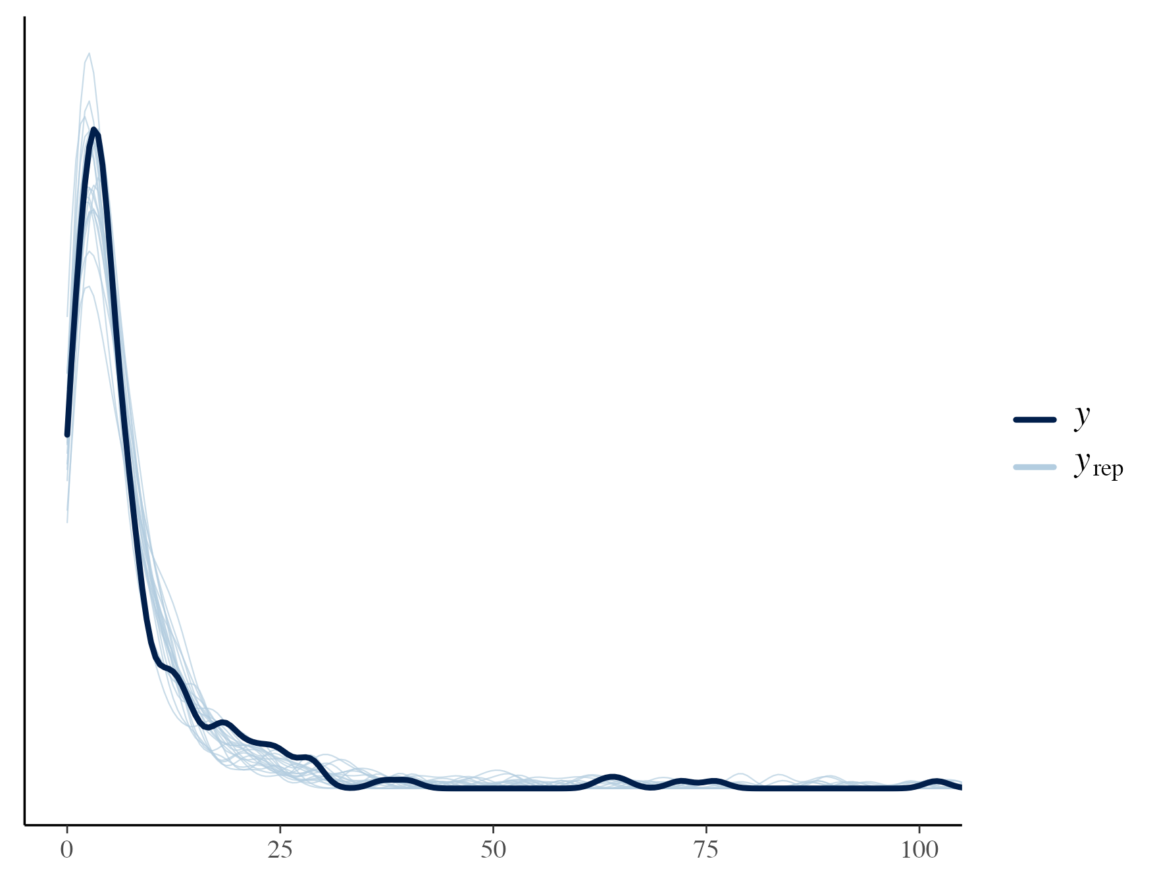
Alternative Models - Marginalisation
Posterior-Predictive Check shows similarly good fit to the observed data
Significantly reduced runtime!
Normal: 9.66 seconds
Gamma: 14.48 seconds
NB: 2.8 seconds
We can do better!

Slide 91

Computational Efficiency
Note the construction of the linear predictor requires multiplying data ($x_{i}^{T}$) with parameters ($β$):
$$λ_{i}=exp⁡(α+x_{i}^{T}β)$$
This means we have to calculate and propagate gradients for each result
We can instead take advantage of Stan’s specialised GLM distributions to identify which components require gradient calculations

Slide 92
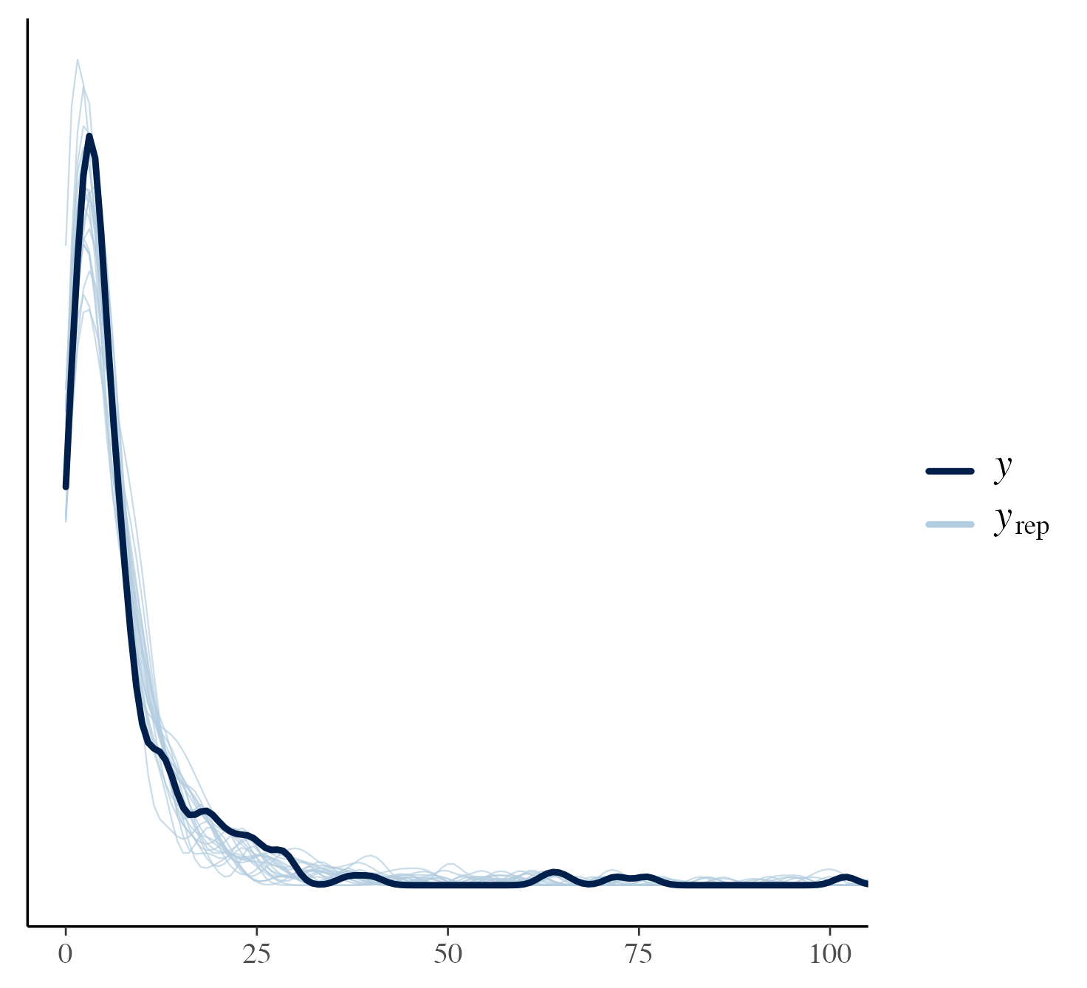
Alternative Models - GLM
Posterior-Predictive Check is near-identical, as the likelihood is the same
Significantly reduced runtime again!
Normal: 9.66 seconds
Gamma: 14.48 seconds
NB: 2.8 seconds
NB + GLM: 1.26 seconds

Slide 93
Compare Models
What were our inferences about the treatment effect between the Poisson-Gamma and the Negative-Binomial (GLM) models?

Slide 94

Compare Models
What were our inferences about the treatment effect between the Poisson-Gamma and the Negative-Binomial (GLM) models?
Poisson:
$β_{treat}=−0.14 [−0.43, 0.15]$
ESS_{bulk} = 680
ESS_{tail} = 1211

Slide 95

Compare Models
What were our inferences about the treatment effect between the Poisson-Gamma and the Negative-Binomial (GLM) models?
Poisson:
$β_{treat}=−0.14 [−0.43, 0.15]$
ESS_{bulk} = 680
ESS_{tail} = 1211
Negative-Binomial:
$β_{treat}=−0.17 [−0.43, 0.09]$
ESS_{bulk} = 1690
ESS_{tail} = 2227

Slide 96
Compare Models
What were our inferences about the treatment effect between the Poisson-Gamma and the Negative-Binomial (GLM) models?
The Negative-Binomial model was both faster and resulted in higher quality estimates

Slide 97

Conclusions
Bayesian inference provides powerful addition to our modelling toolkit
Multiple pathways we can take in developing a Bayesian model
Following a structured workflow can help reduce unnecessary work and ad-hoc decision-making

